Slide 1
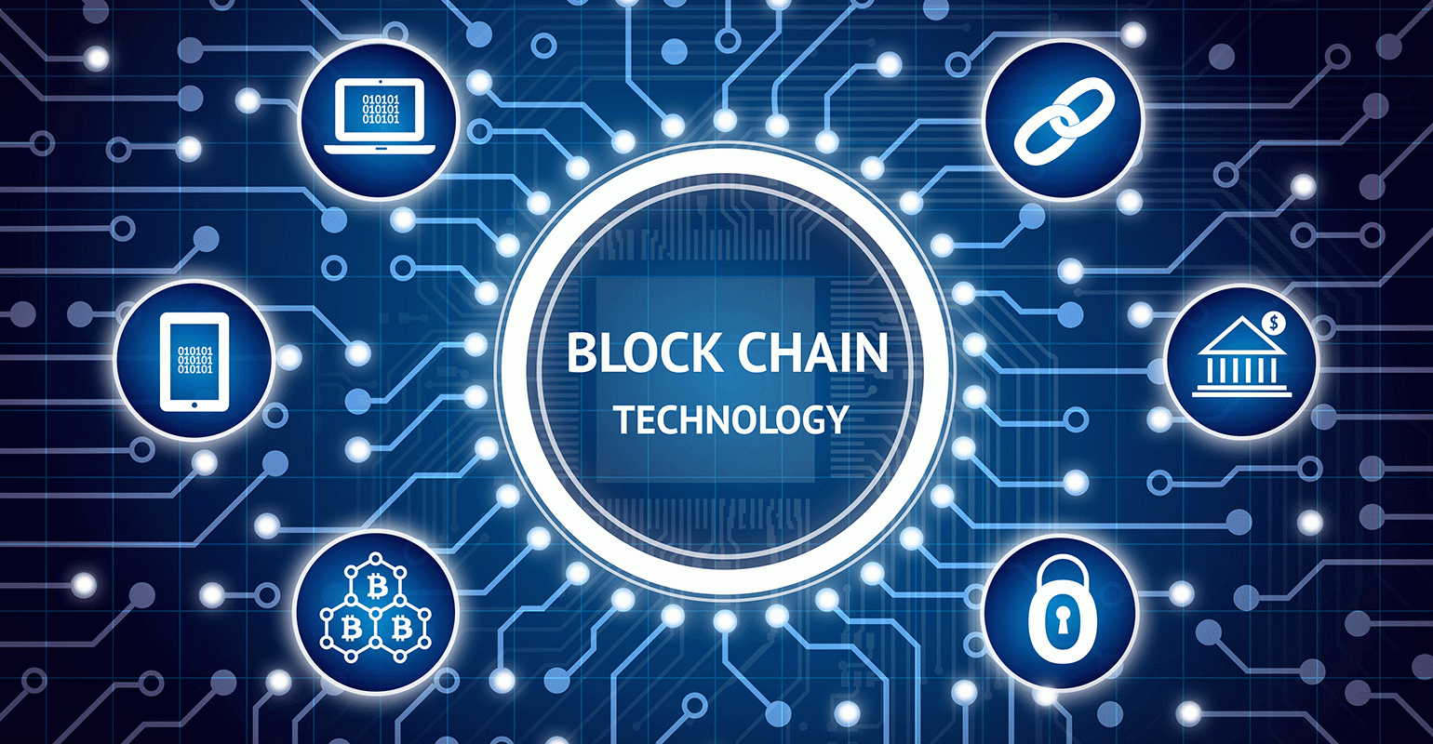

Slide 2
Abstract
What is Blockchain ?
Why Blockchain
Pillars of Blockchain
Blockchain Basic Architecture
How Blockchain works
Proof Of Work
Use Cases & Practical Implementation
Limitation Of Blockchain Technology
Summary

Slide 3

What IS BLOCKCHAIN?
In simple words, Blockchain can be defined as a chain of the block that contains information.
This technique is intended to timestamp digital documents so that it's not possible to backdate them or temper them. This technology was originally described in 1991 and was intended to timestamp digital documents to avoid backdate or tempering of any records.
The term Blockchain became popular when an anonymous person or a group of people known as Satoshi Nakamoto published a paper on the Bitcoin cryptocurrency

Slide 4
Different Framework for Enterprise Blockchain Implemenation
Hyperledger : Supported by Linux Foundation and IBM.
Ethereum : a private blockchain framework from Ethereum.
Multichain : a open platform for building blockchains.
Eris Industries : a low cost blockchain implementation framework.
R3 Corda : Corda is a blockchain framework designed specifically for BFSI industry.
Openblockchain : a open blockchain fabric code framework.

Slide 5
USE cases
Bank Use
Healthcare Uses
Use in CryptoCurrency
PropertyRecord Uses
Supply Chain Use
In Smart Contracts
In Voting

Slide 6
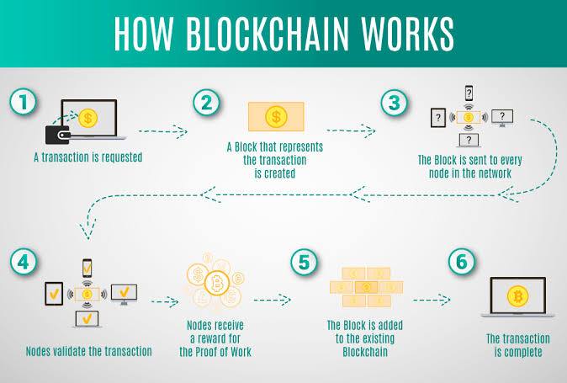
How Blockchain works

Slide 7
What is a Block?
“Blocks” on blockchain are made up of digital pieces of information.
Basically they have three parts:
Data
Participants present in the transaction
A unique information to separate them from other blocks in the network
Block1
Block2
Block3
Block N
Genesis Block

Slide 8
Proof of work & Proof of stake
Hashes are an excellent mechanism to prevent tempering but computers these days are high-speed and can calculate hundreds of thousands of hashes per second. This might be raise security concern as attacker can change hashes of all block in network in few minutes.
Proof of work helps to slow down the block creation process thus preventing it from any attack.
“A proof-of-work is a computational problem that takes certain effort to solve. But the time required to verify the results of the computational problem is very less compared to the effort it takes to solve the computational problem itself”
In case of Bitcoin, it takes almost 10 minutes to calculate the required proof-of-work to validate and add a new block to the blockchain

Slide 9
Why Blockchain
Few reasons why this technology is becoming popular
Resilience
Time Duration
Reliability
Fraud prevention
Security
Collaboration

Slide 10
Three Pillars OF Blockchain
Decentralization
Transparency
Immutability

Slide 11

Decentralization
In a decentralized system, the information is not stored by one single entity. In fact, everyone in the network owns the information.
In a decentralized network, if you wanted to interact with your friend then you can do so directly without going through a third party

Slide 12
The New Networks
Centralized Decentralized
Central system have a core authority that dictates the truth to other participants in the network
Only privileged users or institutions can access the transaction history and confirm a new transaction
Decentralized system have no core authority that dictates the truth to other participants in the network
Every participants in the network can access the transaction history and confirm a new transaction

Slide 13
Transparency
Transparency is one of the major feature in blockchain. It is one of the most interesting and misunderstood concepts. Some people say that blockchain gives you privacy while some say that it is transparent
In any transaction that happens in a blockchain network a participant identity is hidden via complex cryptography and is represented using their public ip address.
Eg. If alice sends 1 bitcoin then you will not see “Alice sent 1 bitcoin” instead it will be like “1MF1bhsFLkBzzz9vpFYEmvwT2TbyCt7NZJ sent 1 bitcoin” in the ledger.

Slide 14
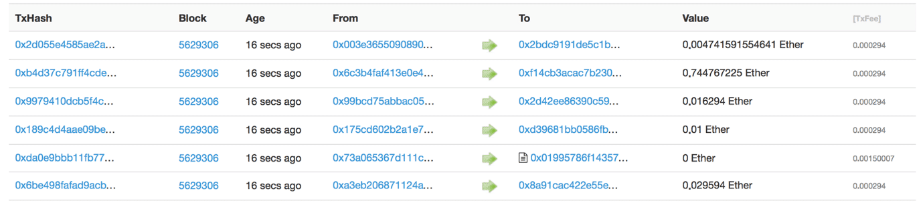
So, while the person’s real identity is secure, you will still see all the transactions that were done by their public address. This level of transparency has never existed before within a financial system. It adds that extra, and much needed, level of accountability which is required by some of these biggest institutions.

Slide 15
Immutability
In context of Blockchain , it means that once something has been entered into the blockchain, it cannot be tampered with.
This is achieved by using the property of cryptographic hash function.
In simple terms, hashing means taking an input string of any length and giving out an output of a fixed length. In the context of cryptocurrencies like bitcoin, the transactions are taken as an input and run through a hashing algorithm (bitcoin uses SHA-256) which gives an output of a fixed length.
There is one property which cryptographic hashing function has called “Avalanche effect”

Slide 16
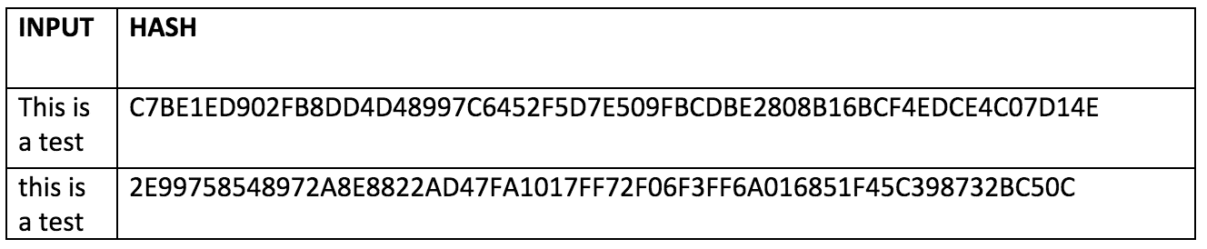
The Avalanche Effect
Even if you make a small change in your input, the changes that will be reflected in the hash will be huge.
Let’s test it out using SHA-256:
As in the above example just by making a small change the hash changes accordingly

Slide 17
Real Life Use Cases
Dubai: The Smart City
In the year 2016, smart Dubai office introduced Blockchain strategy. Using this technology entrepreneurs and developers will be able to connect with investor and leading companies. The objective is to implement blockchain base system which favors the development of various kind of industries to make Dubai 'the happiest city in the world.'
Blockchain for Humanitarian Aid
In January 2017 the united nations world food program started a project called humanitarian aid. The project was developed in rural areas of the Sindh region of Pakistan. By using the Blockchain technology, beneficiaries received money, food and all type of transactions are registered on a blockchain to ensure security and transparency of this process.

Slide 18
Summary
A Blockchain is a chain of blocks that contain information
Every block contains hash.
Each block has a hash of the previous block
Blockchain require Proof of Work before a new block is added
The blockchain database is disturbed amongst multiple peers and is not centralized.
Block chain technology is Resilience, Decentralize, Time reducing, reliable and its offers unalterable transitions
Higher cost, slower transactions, small ledger, the risk of error are some disadvantage of using this technology
Dubai- The Smart City, Incent Customer retention, and Blockchain for Humanitarian Aid are the real-life use cases of Blockchain
Bitcoin uses blockchain technology which is not governed by any central authority or banks

